Slide 1
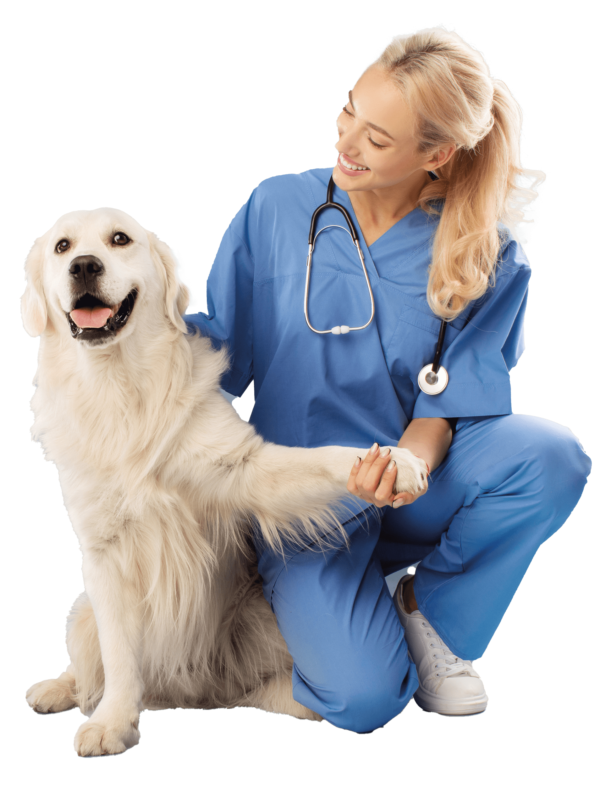
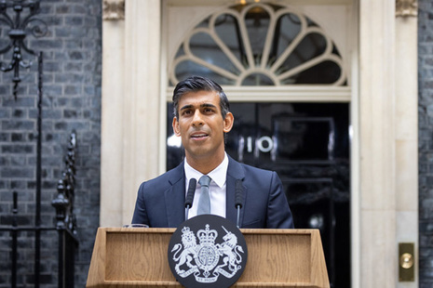
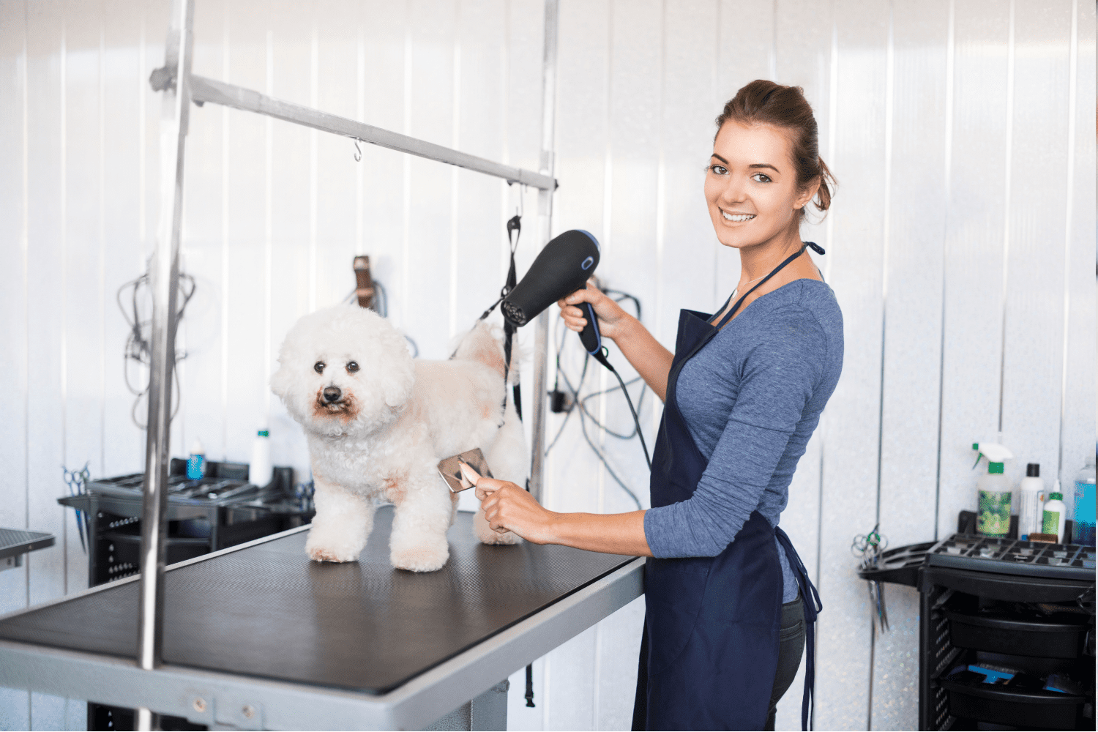
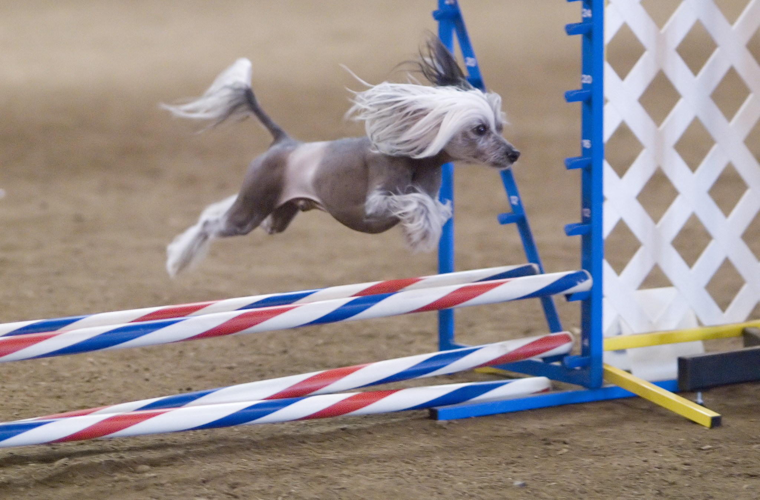
Joseph Kemp
The Project Idea
There are many practical applications of our application, such as, use in the veterinary field. For example, it can be used to identify dogs when they have been admitted to the vet and the owner is not 100% sure on the breed. This could be crucial as different breeds have different reactions to some medication. Our application would allow for vets to be sure to administer the correct medication to every dog. The app can also be used in veterinary training. This is by training students to better identify dogs by using random images and outputting the answer after they’ve guessed.
Pet stores, groomers and trainers could also use it to identify what dog they are selling/providing a service for. As well as this dog shelters could use it to identify stays and get them the correct help that they could desperately need.
It could also be used in various competitions so that the registration process is more streamlined, and the wrong dog isn’t put into the wrong competition. Ensuring a level playing field.
It can even be used by the government to check whether a dog is a breed that is illegal in that country.

